Slide 1


OpenAI
OpenAI is an AI research and deployment company. Our mission is to ensure that artificial general intelligence benefits all of humanity.

Slide 2
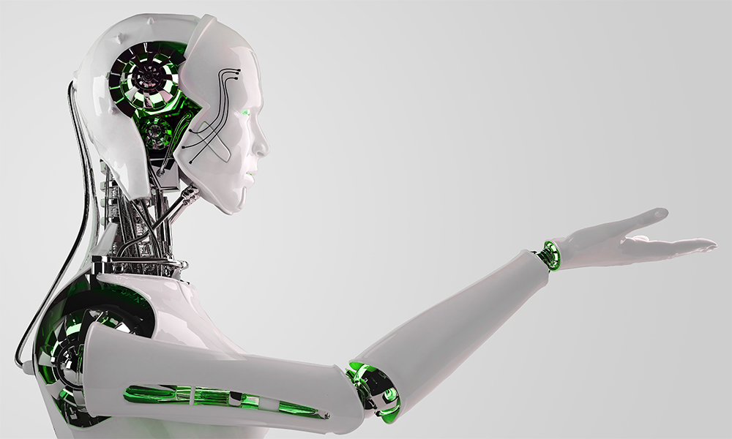

About
OpenAI
OpenAI is an artificial intelligence research laboratory consisting of the for-profit OpenAI LP and its parent company, the non-profit OpenAI Inc.

Slide 3
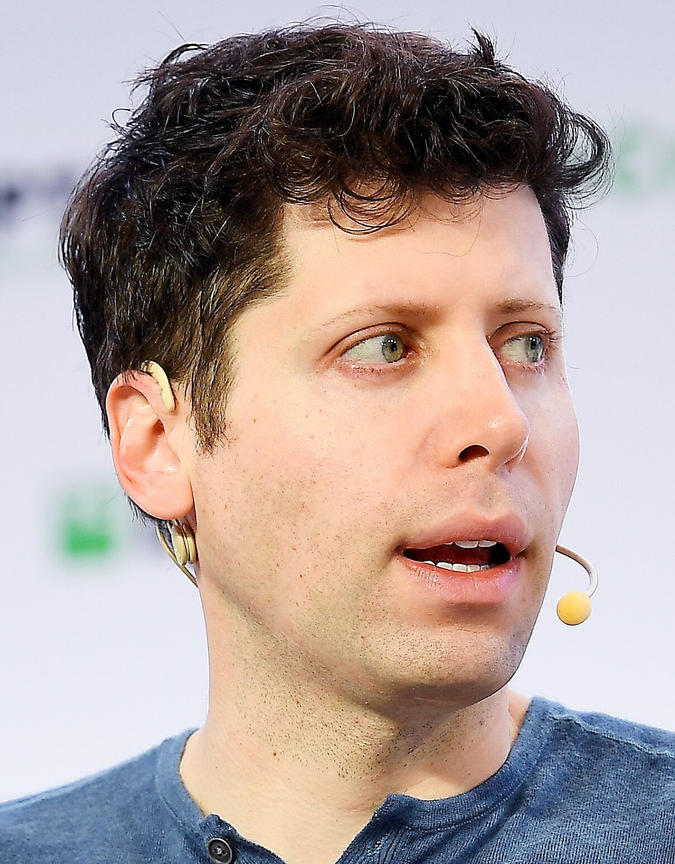

OpenAI
CEO
Sam Altman. CEO
2021, Sam Altman is the current CEO of OpenAI.

Slide 4
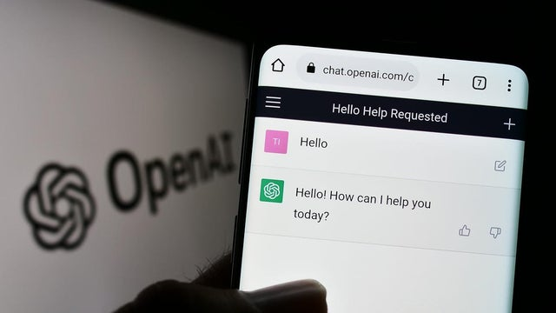
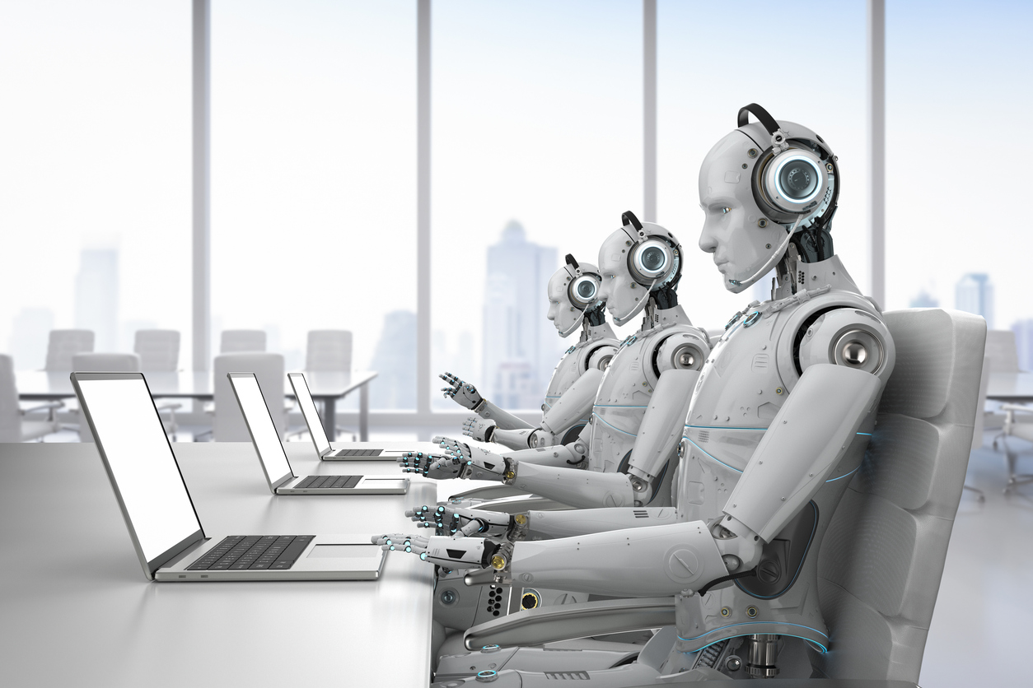
OpenAI’s Goals
The goals of OpenAI are to develop and promote friendly AI in a way that benefits all of humanity. They conduct research in a variety of areas related to AI, including machine learning, computer vision, natural language processing, and robotics.

Slide 5
NATURAL LANGUAGE PROCESSING
Natural language processing (NLP) is an interdisciplinary subfield of linguistics, computer science, and artificial intelligence concerned with the interactions between computers and human language, in particular how to program computers to process and analyze large amounts of natural language data. The goal is a computer capable of "understanding" the contents of documents, including the contextual nuances of the language within them

Slide 6
OpenAI API’s APIs play the role of intermediary between two applications. The OpenAI API can also be used to generate and edit images or convert speech into text. Features of OpenAI API’s: Powerful language processing Accessibility Continuous improvement Scalability Diverse applications

Slide 7
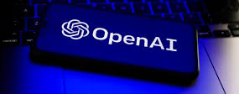
Built With OpenAi’s API
OpenAI API has been deployed in thousands of applications with tasks ranging from helping people learn new languages to solving complex classification problems.
GitHub Copilot
AI pair programmer that helps you write code faster with less work. Using Codex, GitHub Copilot applies the context in your editor and synthesizes whole lines and even entire functions of code.
Keeper Tax
Helps freelancers automatically find tax-deductible expenses by using GPT-3 to interpret data from their bank statements into usable transaction information.
Viable
Helps businesses better and more quickly understand what customers are telling them by using language models, including GPT-3, to analyze customer feedback and generate summaries and insights.
Duolingo
Uses GPT-3 to provide French grammar corrections. An internal Duolingo study shows that use of this feature leads to measurably better second language writing skills!

Slide 8
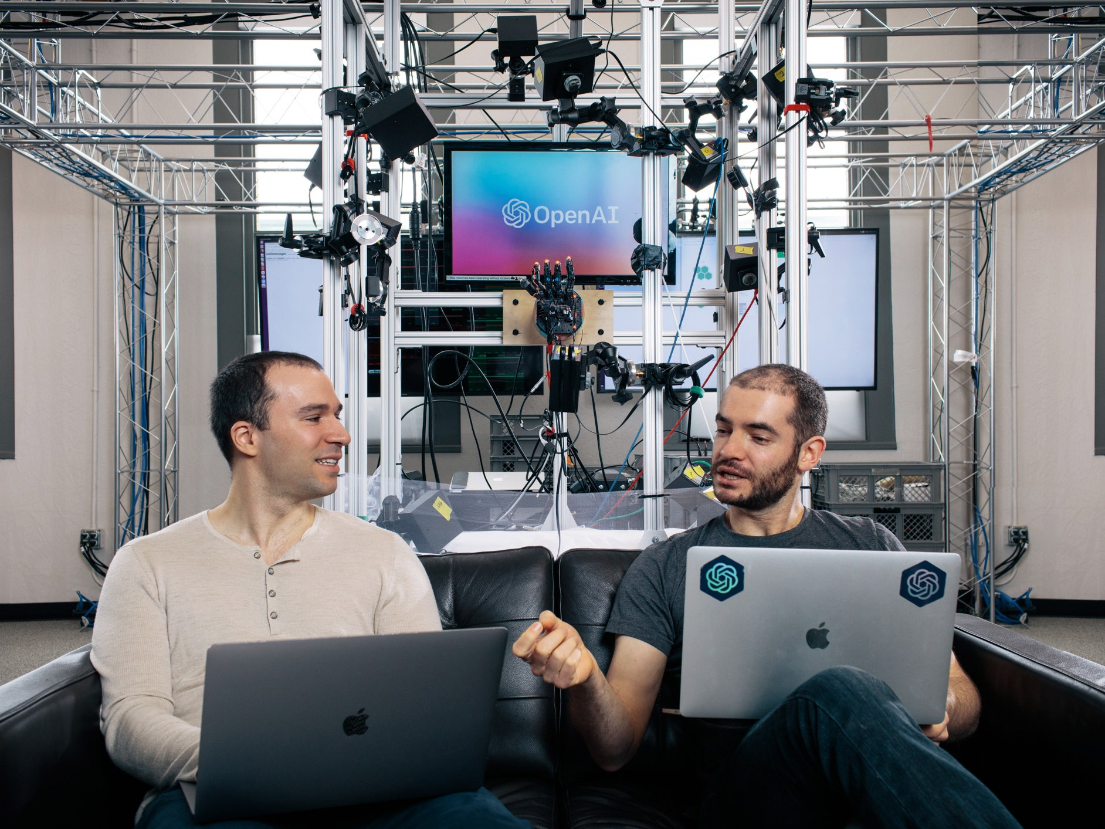

OpenAI’s
Mission
OpenAI's mission is to ensure that artificial general intelligence (AGI) benefits all of humanity. The company has a strong emphasis on transparency and open research, and they release many of their research papers and models under open-source licenses.
OpenAI also offers a cloud-based platform for developers and researchers to access and use their AI models and tools.

Slide 9
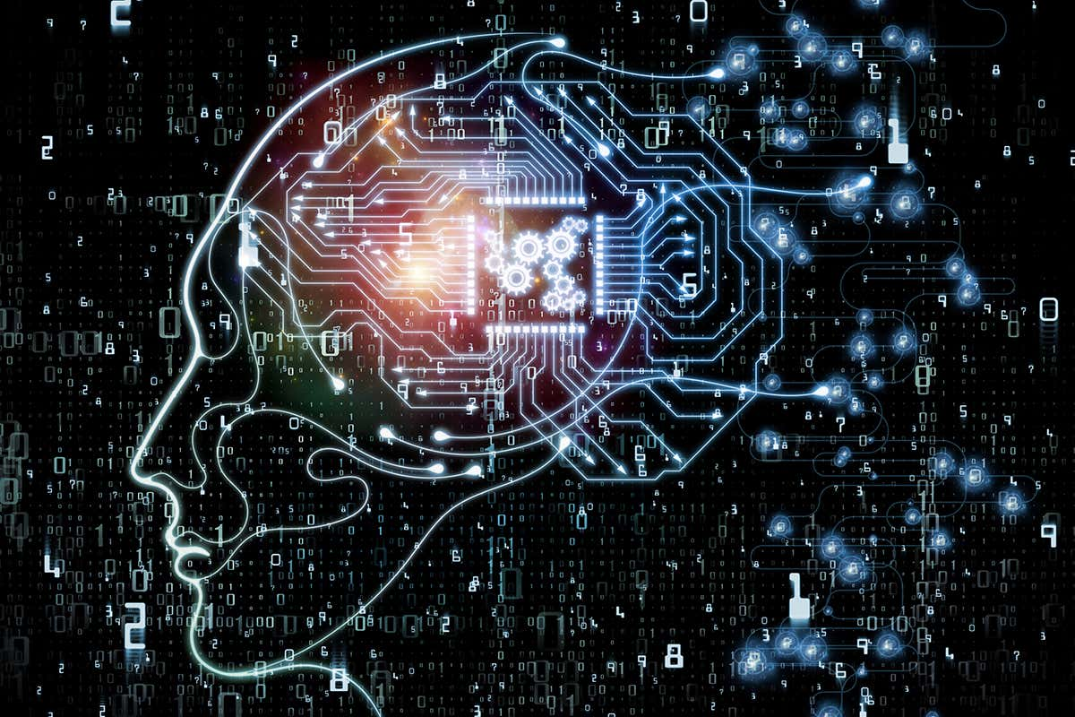
OpenAI’s
Vision
OpenAI's vision is to develop and promote friendly AI in a way that benefits all of humanity. The company aims to create AI that can help humanity achieve its potential by making it more intelligent and capable and by ensuring that it is aligned with human values and developed in a safe and responsible manner.

Slide 10
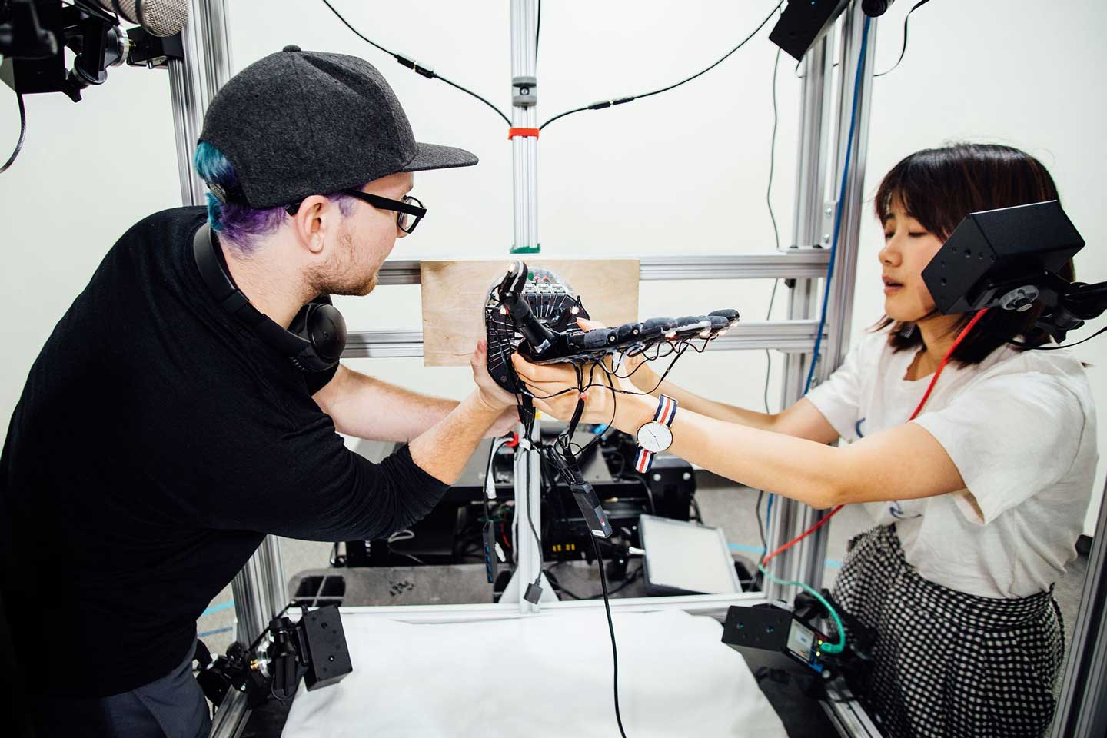
01
ChatGPT
Our
Featured
02
DALL·E 2
OpenAI has achieved several notable milestones and has been featured in many publications for their work on artificial intelligence. Some examples include:
03
Whisper
04
Alignment
05
Startup Fund

Slide 11

ChatGPT
ChatGPT is a large language model. It is based on the transformer architecture and is trained on a dataset of internet text to generate human-like responses to natural language prompts. It is capable of performing a wide range of language tasks such as question answering, text completion, and language translation. The model's performance can be fine-tuned for specific applications by training it on a task-specific dataset.

Slide 12
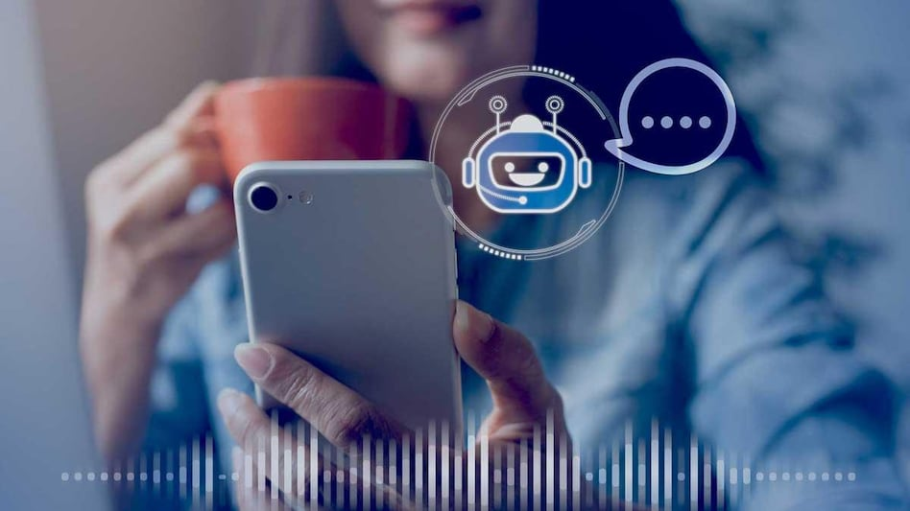
Language Generation
Question Answering
Text Completion
Language Translation
Summarization
ChatGPT Usage

Slide 13

Step 1: Create an account on the OpenAI website.
Step 2: Obtain an API key, which you'll use to authenticate your API calls.
Step 3: Use one of the API client libraries provided by OpenAI, such as the Python library, to interact with the API in your code.
Step 4: You can use the API to generate text in a variety of formats and lengths, and control the level of completeness of the generated text.
How To Get Chat GPT?

Slide 14
Example for converting audio into text using API
pip install openai
#to install openai module
import openai
openai.api_key='skKzBloZKvms9k3b6HjDnZT3BlbkFJFSEGX9OGjNkJ2DaBmzAy’
Audio_file=open('Audio_file.mp3','rb’)
transcript=openai.Audio.transcribe('whisper-1',Audio_file)

Slide 15
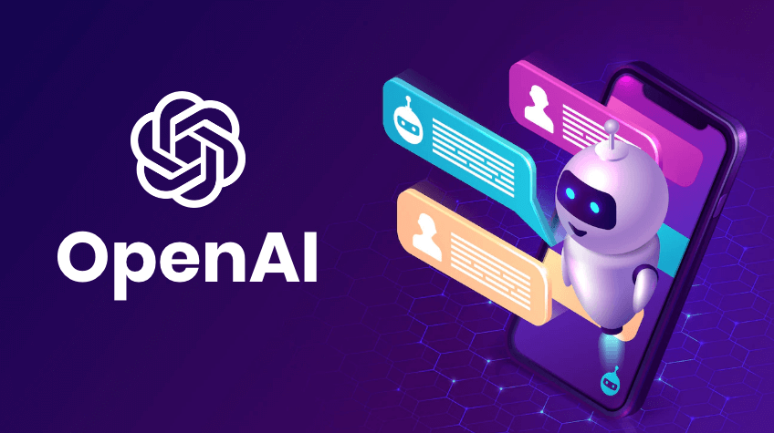





Text completion
Generate and edit text
Image generation
Generate and edit images
Embeddings
Search, classify, and compare text
Code completion
Generate, edit, and explain code
Build
An Application
Fine-tuning
Train a model for your use case

